Slide 1

FACTSPAN
Converting Data into Business insights
Capstone Project
Team 5
DVD Rental Analysis
1
FACTSPAN ANALYTICS

Slide 2


Team 5:
Name | Factspan ID
Lokarapu Sivaji | sivaji.lokarapu@factspan.com
Chintapatla Snetha | snetha.chinthapatla@factspan.com
Jayesh Ravindra Nikam | jayesh.nikam@factspan.com
Aastha Luthra | aastha.luthra@factspan.com
Shubham Gupta | shubham.gupta@factspan.com
Mentor :
Krishika Ramaswamy
krishika.r@factspan.com

Slide 3

Outline:
01
Project Details
02
Timeline
Data Architecture and Solution
03
04
Dashboard I - Summary
Dashboard II – Customer Centric Insights
05
06
Dashboard III– Rental Centric Insights

Slide 4
Project Details
Requirements
Top 10 Customer Analysis
Most Rented Film Analysis
Tools Required:
PostgreSQL
Python
Excel
Tableau
Jira
Problem Statements
DVD Rental Database
A DVD rental business rents out DVDs
Database has 15 tables
Actor | Country | Inventory
Address | Film Category | Rental
Category | Film | Payment
Customer | Film Actor | Staff
City | Language | Store

Slide 5
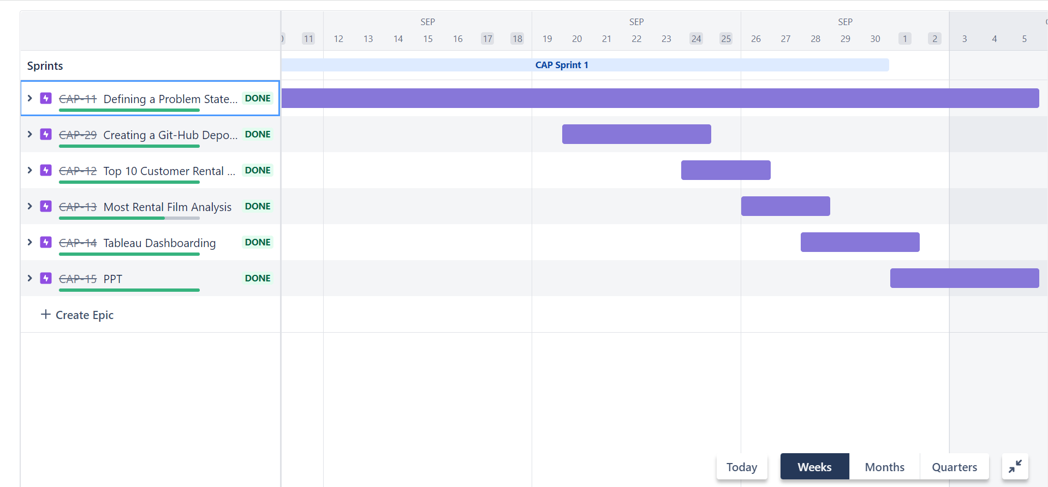
Timeline
JIRA (Project Management Tool)
02
03
04
05
06
07

Slide 6




Data Flow Architecture & Solution Approach
01
02
PostgreSQL
03
Extraction
EDA
04
Master table
Connect to Python
Tranformation
Database (dvdrental)
SQL to join required table
05
06
Data Exploration
Tableau Dashboard
Load
Load
GitHub

Slide 7
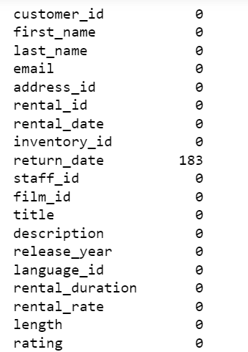
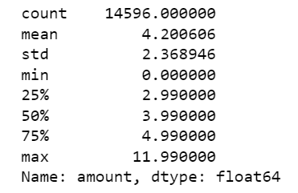
Data Flow Architecture & Solution Approach
Data Exploration
Attributes
01
No. of null values
02
03
04
05
06
For return_date there are 183 Null values. It represents customers have not returned DVD set till date.
07

Slide 8
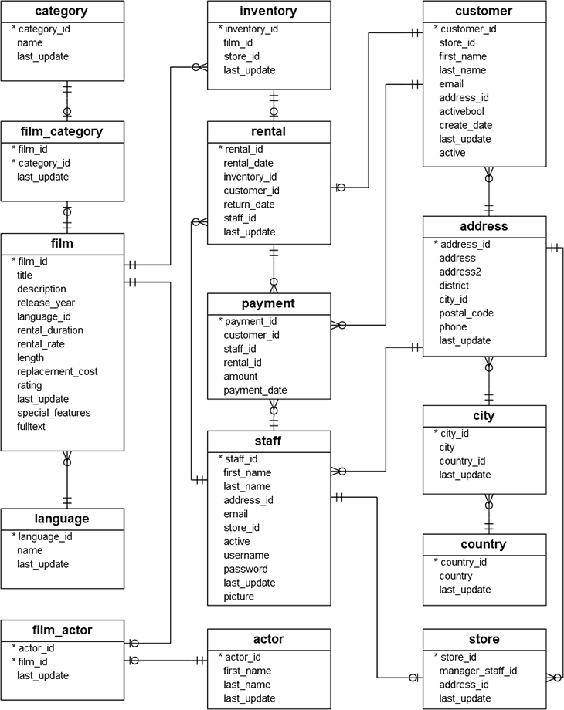
Data Flow Architecture & Solution Approach
Data Exploration
Most Rented Film Analysis
01
02
Table name | Key attribute
country | Country_id
payment | amount
Film_category | Category_id
film | Rating
Rental | Rental_date, return_date
03
04
05
06
07

Slide 9
Data Flow Architecture & Solution Approach
Data Exploration
Top 10 Customers
01
02
Table name | Key attribute
country | Country_id
payment | amount
Film_category | Category_id
film | Rating
Rental | Rental_date, return_date
03
04
05
06
07

Slide 10
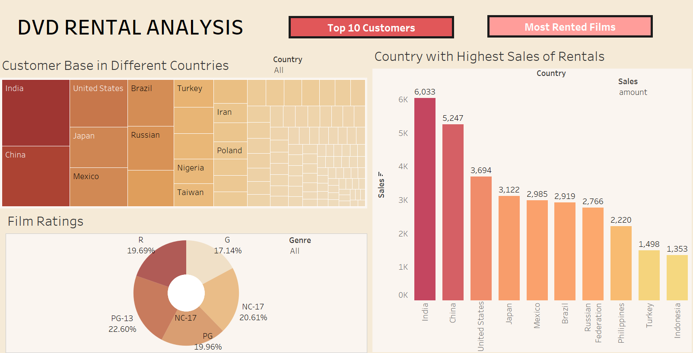

Slide 11
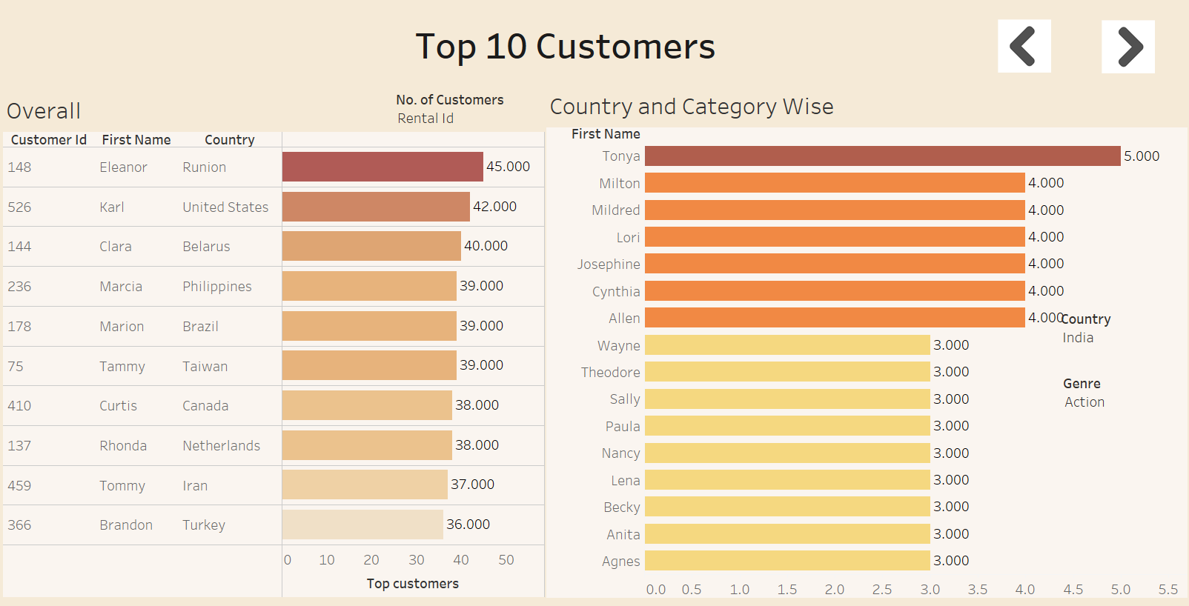

Slide 12
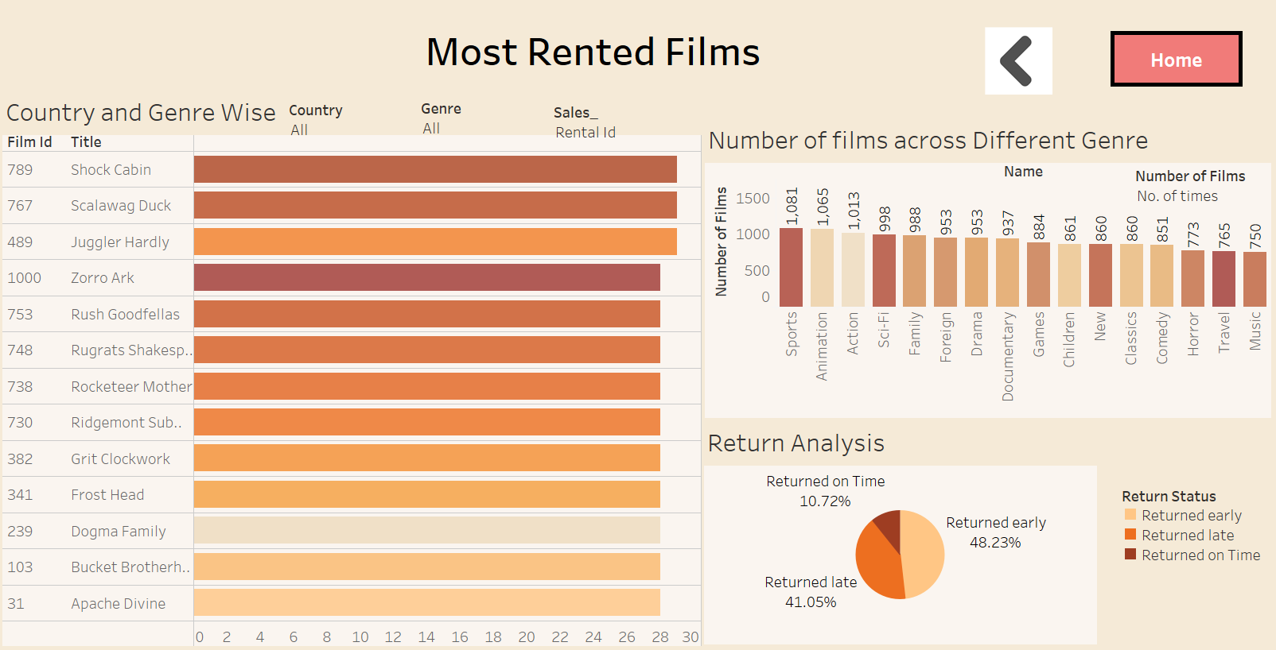

Slide 13
URL - Links
Git Hub Repository link: https://github.com/snethac/capstone-batch-5
JIRA link: https://sivajilokarapu.atlassian.net/jira/software/projects/CAP/boards/2/roadmap
01
02
03
04
05
06
07

Slide 14
Thank You

